Slide 1
MVC FRAMEWORK

Slide 2
AGENDA
What is MVC?
Controllers and Routing
Views
Models (Data)
Demo

Slide 3
MVC design pattern
Controller
Model
View
Model objects are the parts of the application that implement the logic for the application's data domain.
Views are the components that display the application's user interface (UI).
Controllers are the components that handle user interaction, work with the model, and ultimately select a view to render that displays UI.

Slide 4
Advantages of an MVC-Based Web Application:
It makes it easier to manage complexity by dividing an application into the model, the view, and the controller.
It does not use view state or server-based forms. This makes the MVC framework ideal for developers who want full control over the behavior of an application.
It provides better support for test-driven development (TDD).

Slide 5
Controller
The ASP.NET MVC framework maps URLs to classes that are referred to as controllers.
Controllers process incoming requests, handle user input and interactions, and execute appropriate application logic.
A controller class typically calls a separate view component to generate the HTML markup for the request.
The base class for all controllers is the ControllerBase class.
All controller classes must be named by using the "Controller" suffix.

Slide 6
ASP.NET MVC Routing Overview
When you create a new ASP.NET MVC application, the application is already configured to use ASP.NET Routing.
The Route table is created in the application's Global.asax file.
The default route table contains a single route (named Default). The Default route maps the first segment of a URL to a controller name, the second segment of a URL to a controller action, and the third segment to a parameter named id.
Example:/Home/Index/3
The Default route maps this URL to the following parameters:
controller = Home action = Index id = 3
The following code is executed:
HomeController.Index(3)

Slide 7
Views
ASPX
<%:.............%>
RAZOR
@..............@
Enclose code blocks.
Variables can be used to store variables.
Enclose literal string values in double quotation marks.
Code is case sensitive.
Much of code involves objects.
Decision making statements can be written.

Slide 8
Advantages of RAZOR programming:
Integrating Content and Code.
Layout/Master Page.
Compact, Clean, Expressive Code.
Encapsulation and Re-Use with HTML Helpers.

Slide 9
Entity Frame Work Data Model
Entity Framework
Schema first
Model first
Code first

Slide 10
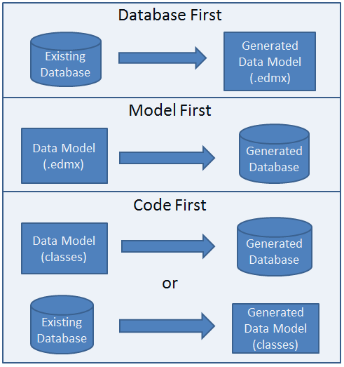
Entity Frame Work Development Approaches

Slide 11
DEMO

